Slide 1

Unit 6: ¡De compras!
Students will be able to talk and describe clothing.
Students will be able to express preferences in the store.
Student will be to negotiate and pay for items you buy.
FINAL DE LA UNIDAD: 28 de marzo

Slide 2
la prueba
1. los calcetines
2. regatear
3. ya
4. de repente
5. hermoso
6. to seem
7. to drive
8. the sweater
9. to loan
10. expensive

Slide 3
Calentamiento
Cambia estos verbos de presente a pasado
  María CORRE
  Teresa CANTA
  Nosotros COMEMOS
  Vosotros COMPRAIS
  Ellos PUEDEN (Stem-changer)!!!!!
  Los perros LLEVAN
  Tú USAS
  YO PAGO (Car-Gar-Zar verb!!!!)

Slide 4
Entonces…aquí hay un pequeño video de el Pretérito para ayudarte a recordar.
Some irregular preterits:
  https://www.youtube.com/watch?v=iFUAWMMdE7c

Slide 6
Un resúmen… para 6º período
AR | ER | IR
-é | -amos | -í | -imos | -í | -imos
-aste | -asteis | -iste | -isteis | -iste | -isteis
-ó | -aron | -ió | -ieron | -ió | -ieron
CAR-GAR-ZAR: Change in the YO form as follows:
-CAR : -QUÉ EMPACAR (to pack) : EMPAQUÉ
-GAR : -GUÉ PAGAR (to pay) : PAGUÉ
-ZAR : -CÉ ALMORZAR : ALMORCÉ

Slide 7
STEM-CHANGING VERBS and some irregulars…
AR and ER stem changing: DON’T CHANGE!!!
  Ex: VOLVER, ALMORZAR, CERRAR
IR stem changing verbs: DO CHANGE
CREER, LEER, OIR: They make the “y” change in the 3rd person:
  Oí, oiste, OYÓ, oímos, oísteis, OYERON
VER: It is regular in the preterit but doesn’t have accents:
  vi, viste, vio, vimos, visteis, vieron

Slide 8
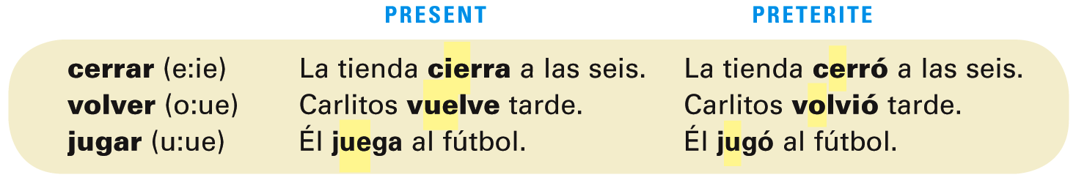
-Ar and -er verbs that have a stem change in the present tense are regular in the preterite. They do not have a stem change.
¡Atención! -Ir verbs that have a stem change in the present tense also have a stem change in the preterite.

Slide 9
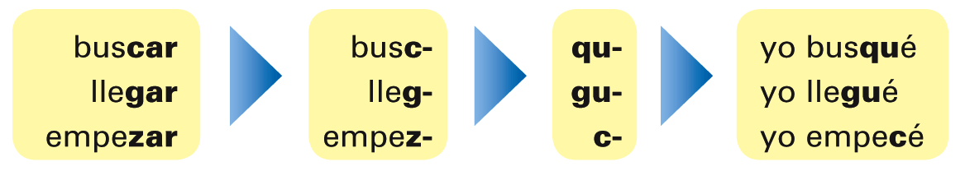
Verbs that end in -car, -gar, and -zar have a spelling change in the first person singular
(yo form) in the preterite.
Except for the yo form, all other forms of -car,
-gar, and -zar verbs are regular in the preterite.

Slide 10
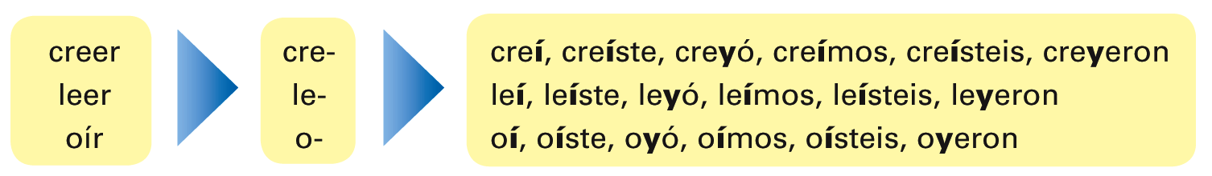
Three other verbs—creer, leer, and oír—have spelling changes in the preterite. The i of the verb endings of creer, leer, and oír carries an accent in the yo, tú, nosotros/as, and vosotros/as forms, and changes to y in the Ud./él/ella and Uds./ellos/ellas forms.

Slide 11
Verb VER: TO SEE and ACABAR DE…
VER: To see
vi | vimos
viste | visteis
vio | vieron
Acabar de….: This phrase it’s used to indicate that something “just happened” and it is used in the present to indicate an immediate event in the PAST…
  Ex: Acabo de enseñarles el pretérito (I just taught you the preterit).

Slide 12
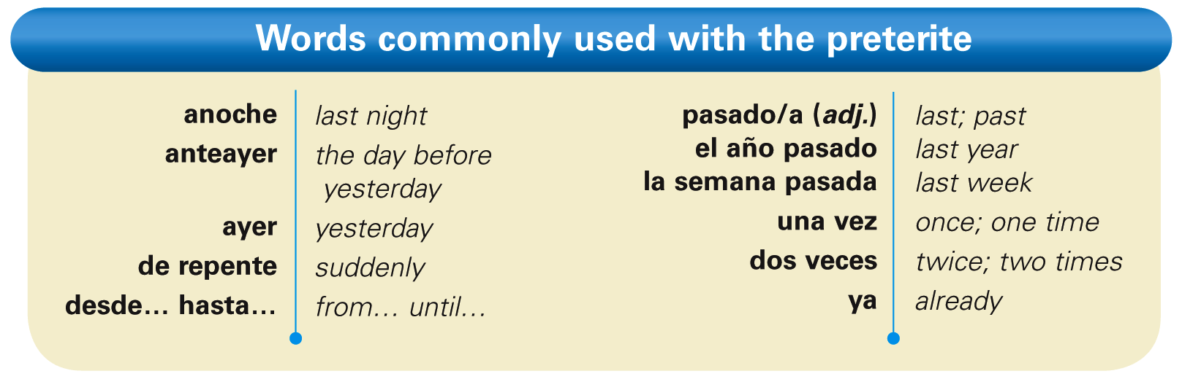
Ver is regular in the preterite, but none of its forms has an accent.

Slide 13
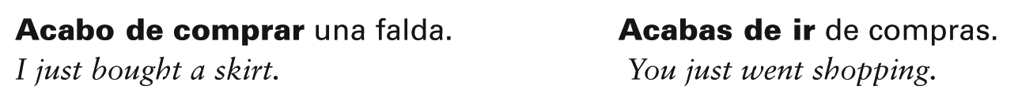
Acabar de + [infinitive] is used to say that something has just occurred. Note that acabar is in the present tense in this construction.

Slide 14

Provide the appropriate preterite forms of the verbs. The first item in each column has been done for you.
ellas ______ ______ ______ ______ tú ______ ______ ______ ______ usted ______ ______ ______ ______ nosotros ______ ______ ______ ______ yo ______ ______ ______ ______
comer
salir
comenzar
leer
comieron
salieron
comenzaron
leyeron

Slide 15
Termina las actividades de la Pág 208 Actividad 3 and 6
Tienes 15 minutos…

Slide 16
Notas: Los adjetivos demonstrativos
So…I’m tired of explaining in class and since you like videos, let’s see if you learn better with somebody else….
http://www.youtube.com/watch?v=ZCBB6ilYSj0

Slide 17


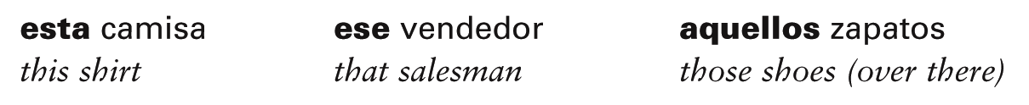
Demonstrative adjectives
In Spanish, as in English, demonstrative adjectives are words that “demonstrate” or “point out” nouns. Demonstrative adjectives precede the nouns they modify and, like other Spanish adjectives you have studied, agree with them in gender and number. Observe these, then study the following chart.

Slide 18
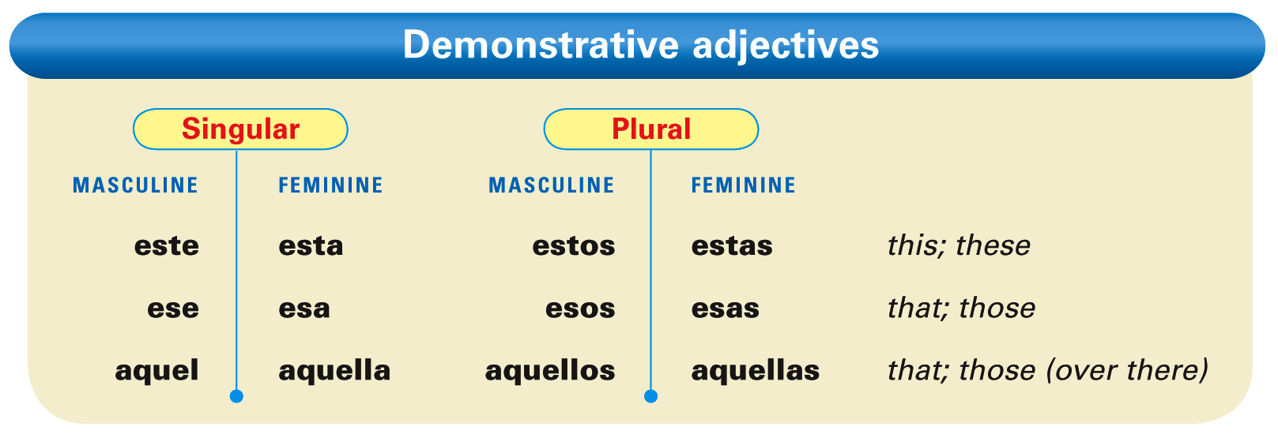

Slide 19
There are three sets of demonstrative adjectives. To determine which one to use, you must establish the relationship between the speaker and the noun(s) being pointed out.

Slide 20
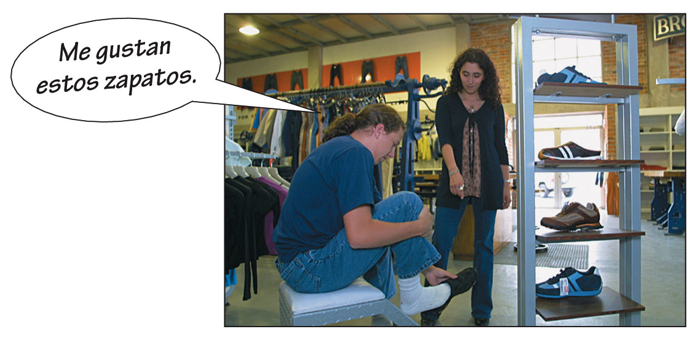
The demonstrative adjectives este, esta, estos, and estas are used to point out nouns that are close to the speaker and the listener.

Slide 21
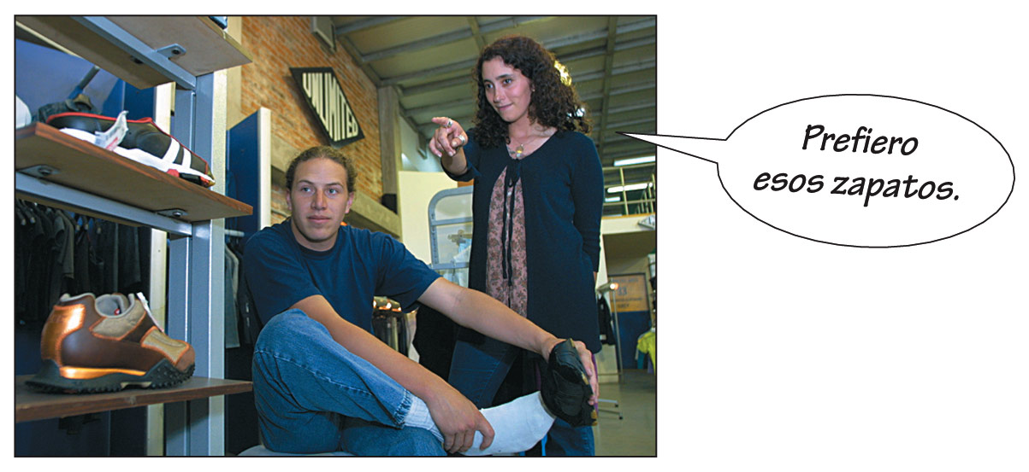
The demonstrative adjectives ese, esa, esos, and esas are used to point out nouns that are not close in space and time to the speaker. They may, however, be close to the listener.

Slide 22
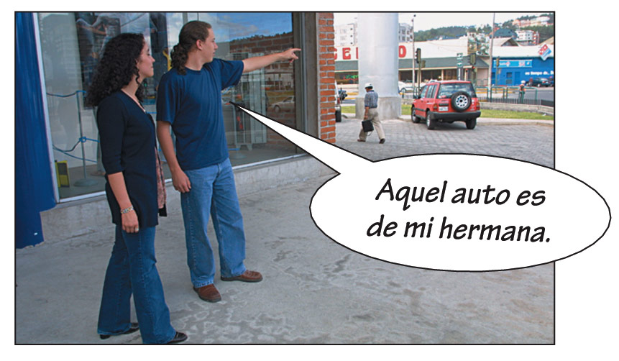
The demonstrative adjectives aquel, aquella, aquellos, and aquellas are used to point out nouns that are far away from the speaker and the listener.

Slide 23
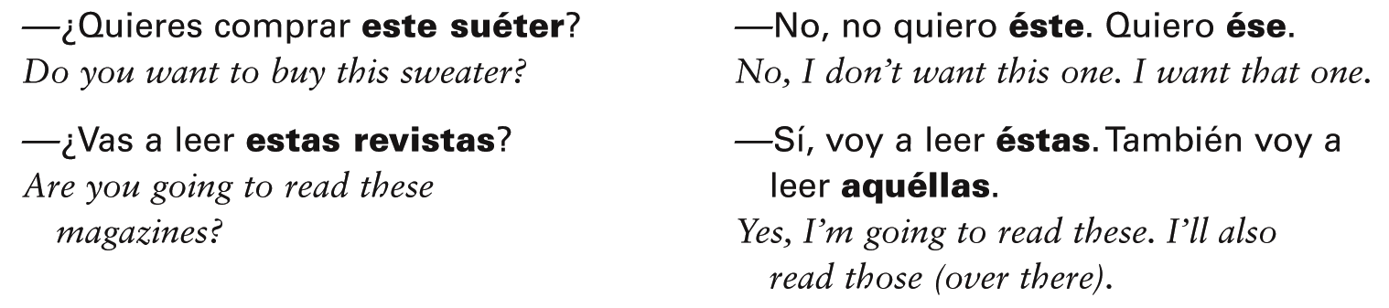
Demonstrative pronouns
Demonstrative pronouns are identical to their corresponding demonstrative adjectives, with the exception that they carry an accent mark on the stressed vowel.

Slide 24
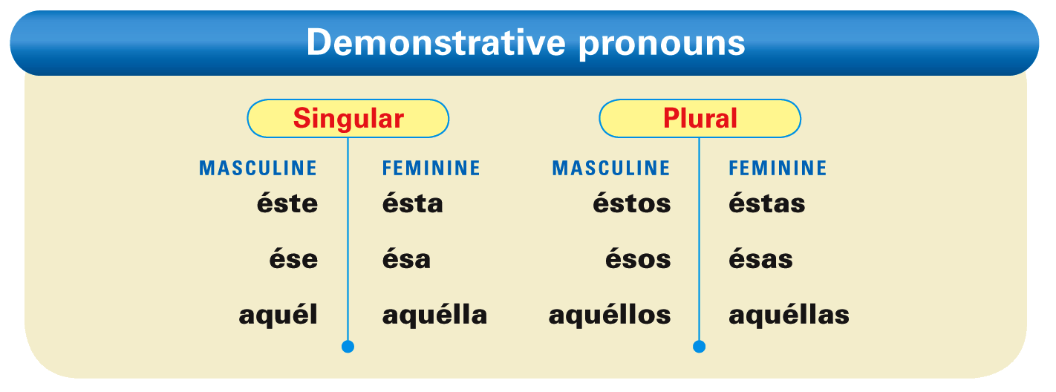

Slide 25
¡Atención! Like demonstrative adjectives, demonstrative pronouns agree in gender and number with the corresponding noun.

Slide 26
There are three neuter demonstrative pronouns: esto, eso, and aquello. These forms refer to unidentified or unspecified nouns, situations, ideas, and concepts. They do not change in gender or number and never carry an accent mark.

Slide 27
Provide the correct form of the demonstrative adjective for these nouns. The first item has been done for you.
la falda / este ____________ los estudiantes / este ____________ los países / aquel ____________ la ventana / ese ____________ | los periodistas / ese ____________ el chico / aquel ____________ las sandalias / este ____________ las chicas / aquel ____________
esta falda

Slide 28
Completa la práctica
Completa los ejercicios de la página 212 Act. 1-2
Completa la tarea….

Slide 29
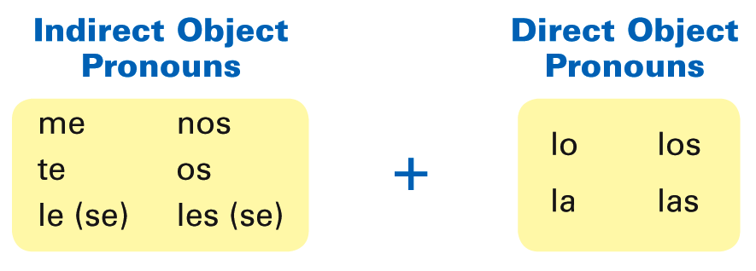
In Lecciones 5 and 6, you learned that direct and indirect object pronouns replace nouns and that they often refer to nouns that have already been referenced. You will now learn how to use direct and indirect object pronouns together. Observe the following diagram.

Slide 30
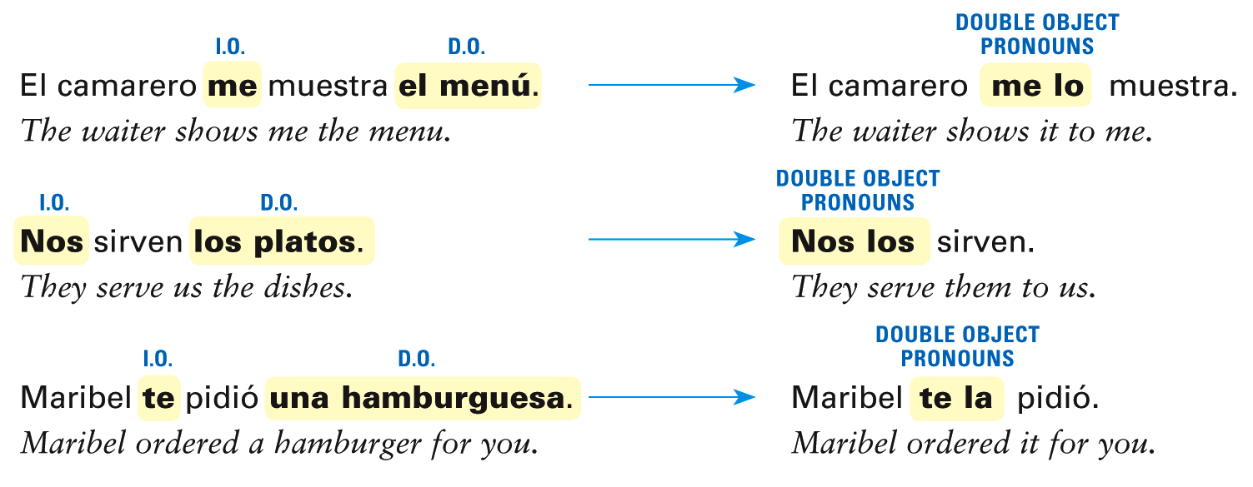
When direct and indirect object pronouns are used together, the indirect object pronoun always precedes the direct object pronoun.

Slide 31
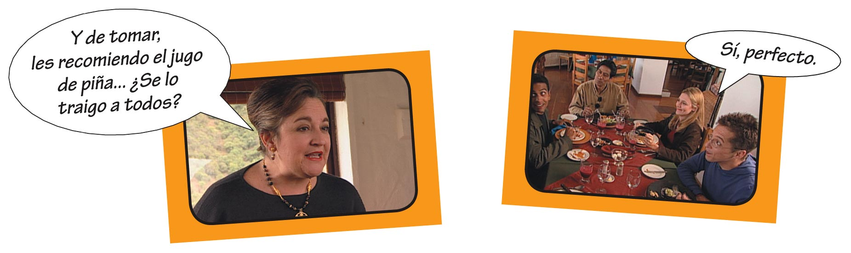

Slide 32
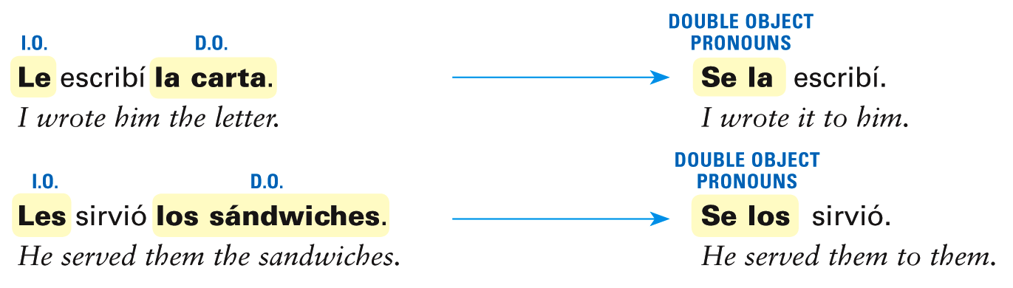
In Spanish, two pronouns that begin with the letter l cannot be used together. Therefore, the indirect object pronouns le and les always change to se when they are used with lo, los, la, and las.

Slide 33
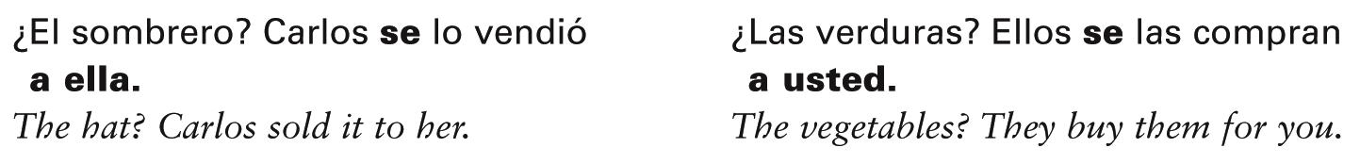
Because se has multiple meanings, Spanish speakers often clarify to whom the pronoun refers by adding a usted, a él, a ella,
a ustedes, a ellos, or a ellas.

Slide 34
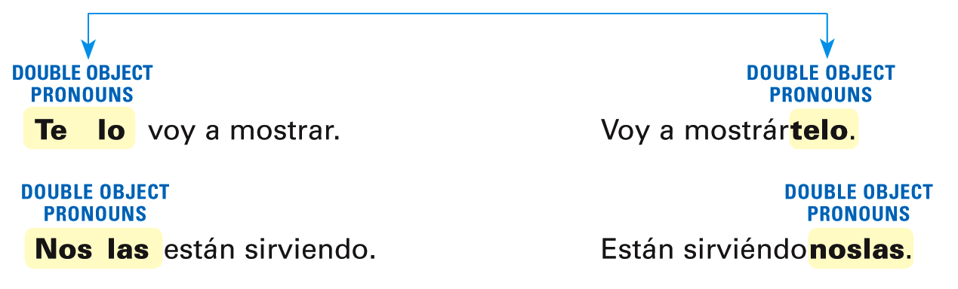
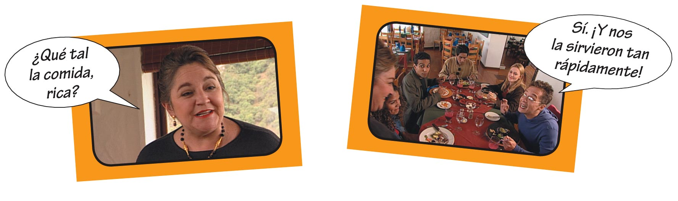
Double object pronouns are placed before a conjugated verb. With infinitives and present participles, they may be placed before the conjugated verb or attached to the end of the infinitive or present participle.

Slide 35
Note that when double object pronouns are attached to an infinitive or a present participle, an accent mark is added to maintain the original stress.

Slide 36
Escribe el pronombre de objeto directo o indirecto que falta en cada oración.
¿La ensalada? El camarero nos _____ la sirvió. ¿El salmón? La dueña me _____ recomienda. ¿La comida? Voy a preparárte _____. ¿Las bebidas? Estamos pidiéndose _____. ¿Los refrescos? Te _____ puedo traer ahora. ¿Los platos de arroz? Van a servírnos _____ después.
Objecto directo
la

Slide 37
Escribe el pronombre de objeto directo o indirecto que falta en cada oración. (cont.)
¿Puedes traerme tu plato? No, no _____ te lo puedo traer. ¿Quieres mostrarle la carta? Sí, voy a mostrár _____ la ahora. ¿Les serviste la carne? No, no _____ la serví. ¿Vas a leerle el menú? No, no _____ lo voy a leer. ¿Me recomiendas la langosta? Sí, _____ la recomiendo. ¿Cuándo vas a prepararnos la cena? _____ la voy a preparar en una hora.
Objecto indirecto
te

Slide 38
Completar…
Página 279: actividad 2.

Slide 39
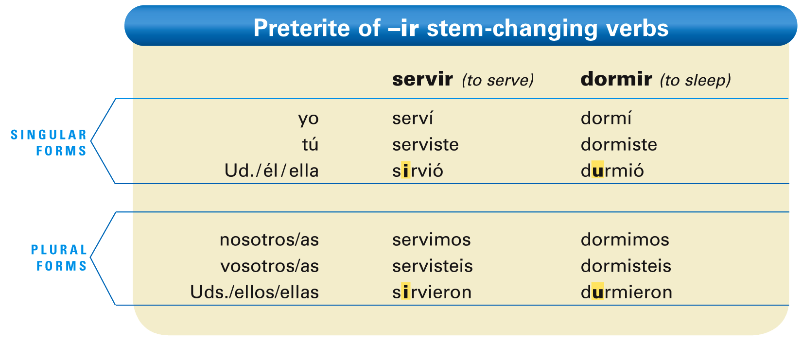
As you learned in Lección 6, -ar and -er stem-changing verbs have no stem change in the preterite.
-Ir stem-changing verbs, however, do have a stem change. Study the following chart and observe where the stem changes occur.

Slide 40
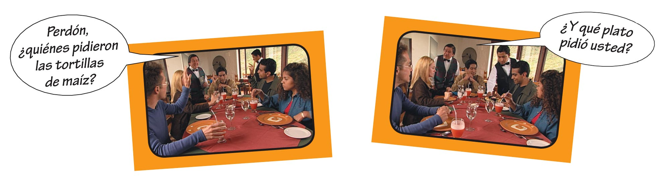
Stem-changing -ir verbs, in the preterite only, have a stem change in the third-person singular and plural forms. The stem change consists of either e to i or o to u.

Slide 41
Cambia cada infinitivo al pretérito.
Yo _____. (servir, dormir, pedir, preferir, repetir, seguir) Usted _____. (morir, conseguir, pedir, sentirse, despedirse, vestirse) Tú _____. (conseguir, servir, morir, pedir, dormir, repetir) Ellas _____. (repetir, dormir, seguir, preferir, morir, servir) Nosotros _____. (seguir, preferir, servir, vestirse, despedirse, dormirse) Ustedes _____. (sentirse, vestirse, conseguir, pedir, despedirse, dormirse) Él _____. (dormir, morir, preferir, repetir, seguir, pedir)
serví

Slide 42
Completar
Página 275: actividad #1

Slide 43
In Lección 6, you learned how to form the preterite tense of regular -ar, -er, and
-ir verbs. The following chart contains the preterite forms of ser (to be) and ir (to go). Since these forms are irregular, you will need
to memorize them.

Slide 44
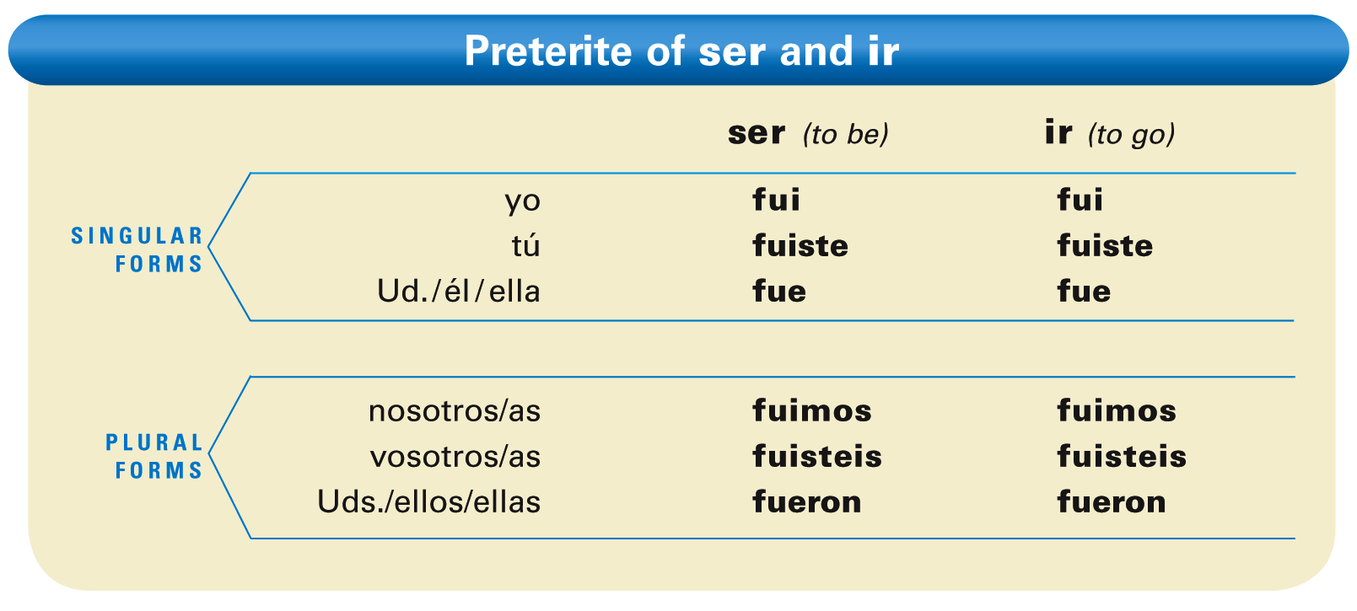

Slide 45
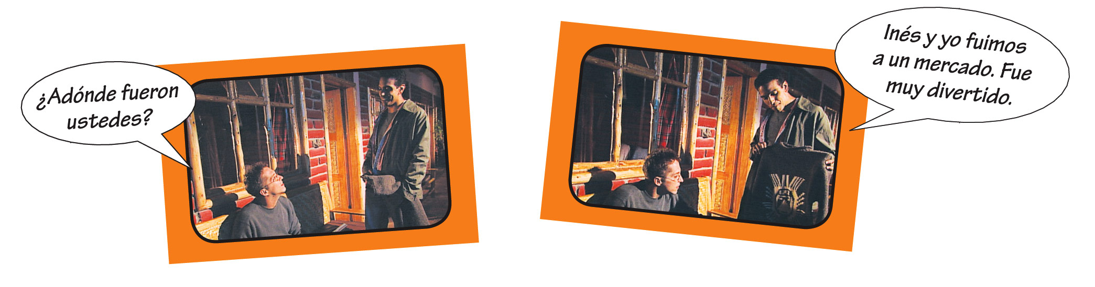
Since the preterite forms of ser and ir are identical, context clarifies which of the two verbs is being used.

Slide 46
Completa las oraciones usando el pretérito de ser e ir. La primera oración de cada columna se da como ejemplo.
Los viajeros ________ a Perú. Patricia _____ a Cuzco. Tú _____ a Iquitos. Gregorio y yo _____ a Lima. Yo _____ a Trujillo. Ustedes _____ a Arequipa. Mi padre _____ a Lima. Nosotras _____ a Cuzco. Él _____ a Machu Picchu. Usted _____ a Nazca. | Usted _______ muy amable. Yo _____ muy cordial. Ellos _____ simpáticos. Nosotros _____ muy tontos. Ella _____ antipática. Tú _____ muy generoso. Ustedes _____ cordiales. La gente _____ amable. Tomás y yo _____ muy felices. Los profesores _____ buenos.
fueron
fue

Slide 47
Completar
Pagina 245: actividades 1 & 2

Slide 48
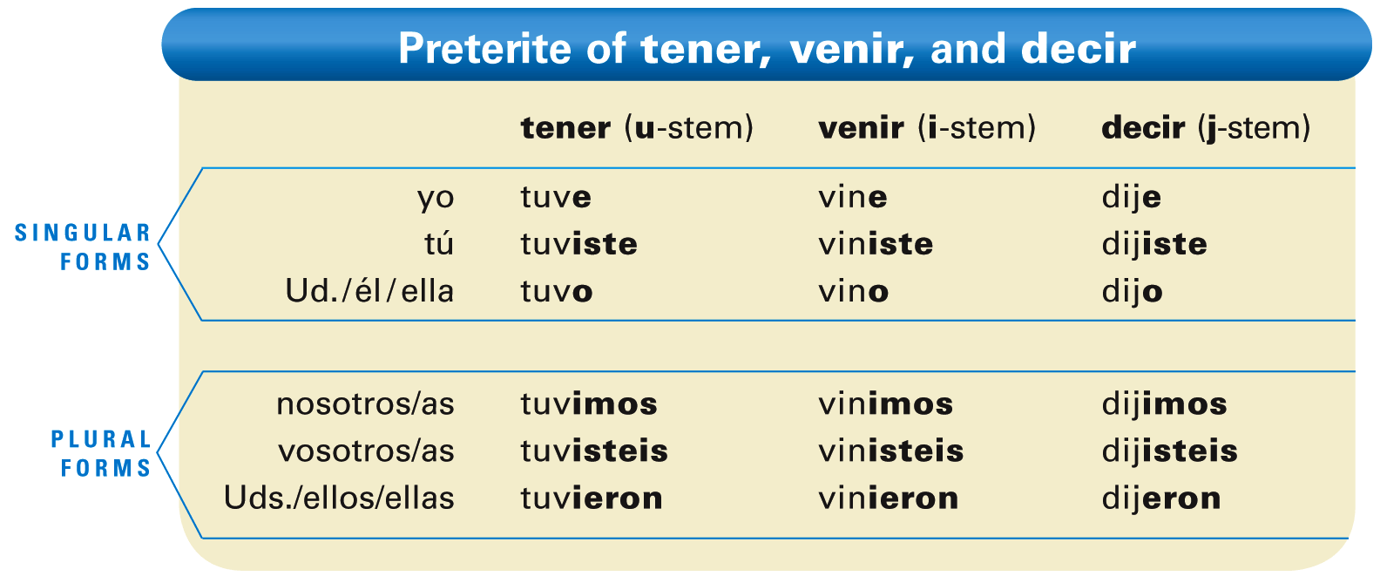
You already know that the verbs ir and ser are irregular in the preterite. You will now learn other verbs whose preterite forms are also irregular.

Slide 49
¡Atención! The endings of these verbs are the regular preterite endings of -er/-ir verbs, except for the yo and usted forms. Note that these two endings are unaccented.

Slide 50
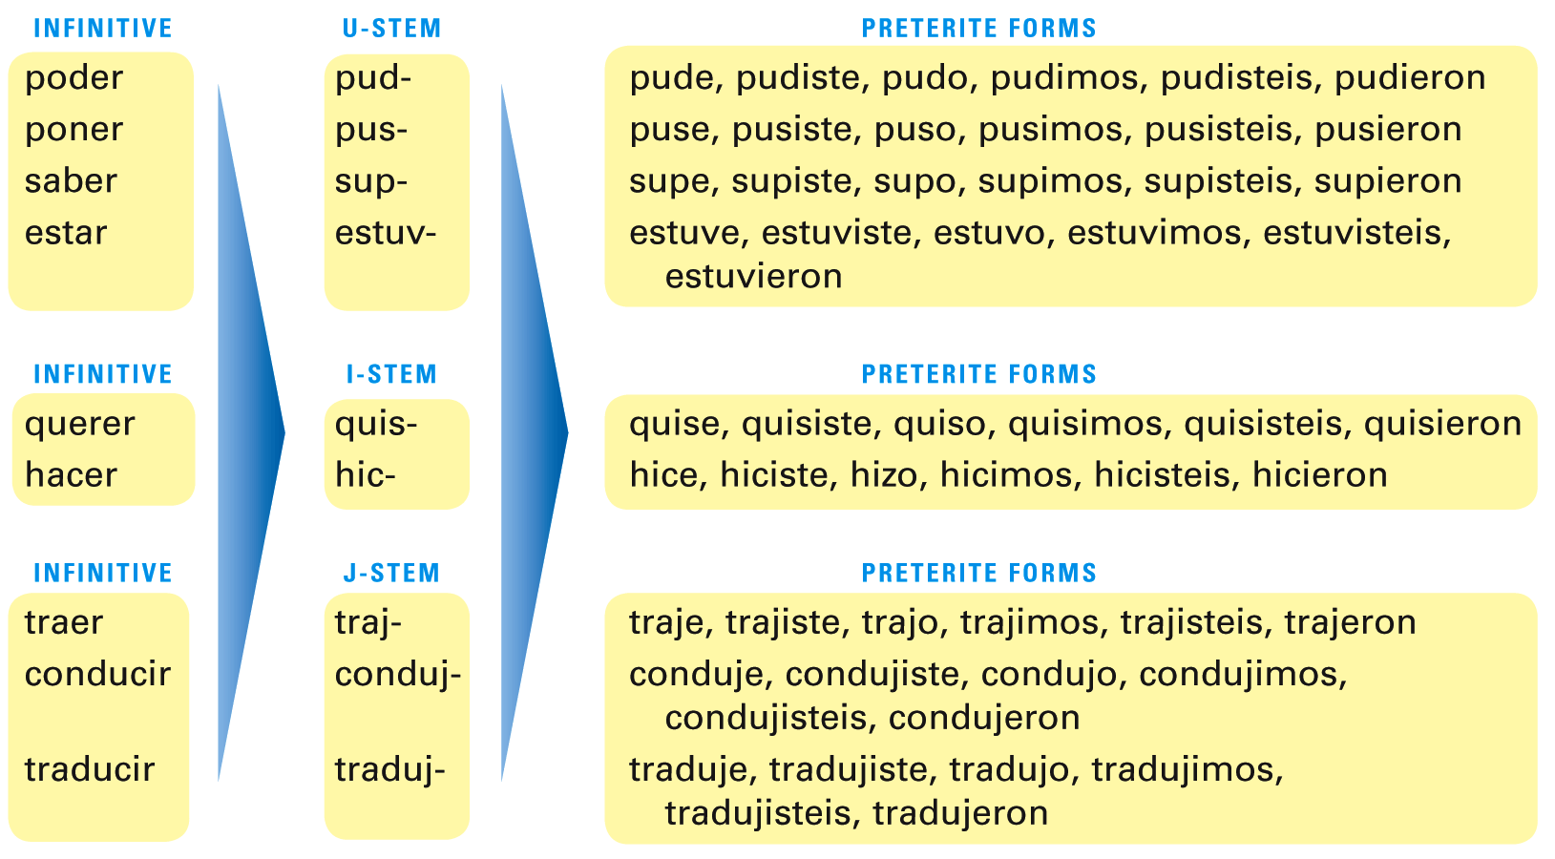
These verbs observe similar stem changes to tener, venir, and decir.

Slide 51
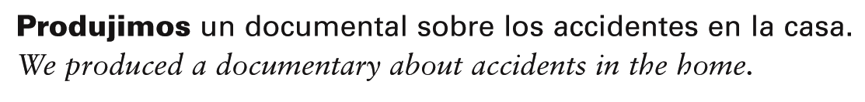
¡Atención! Most verbs that end in -cir are
j-stem verbs in the preterite. For example, producir  produje, produjiste, etc.

Slide 52
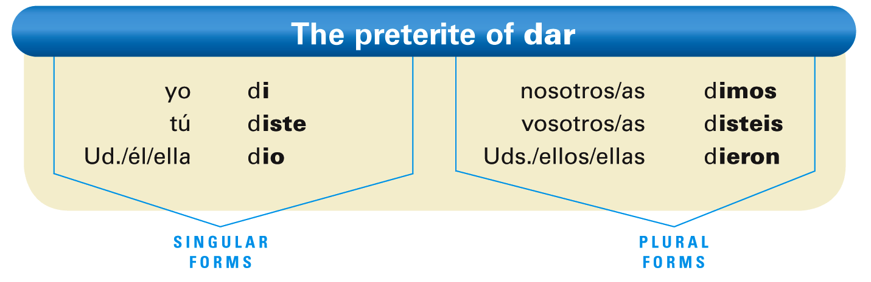
Notice that the preterites with j-stems omit the letter i in the ustedes/ellos/ellas form.

Slide 53
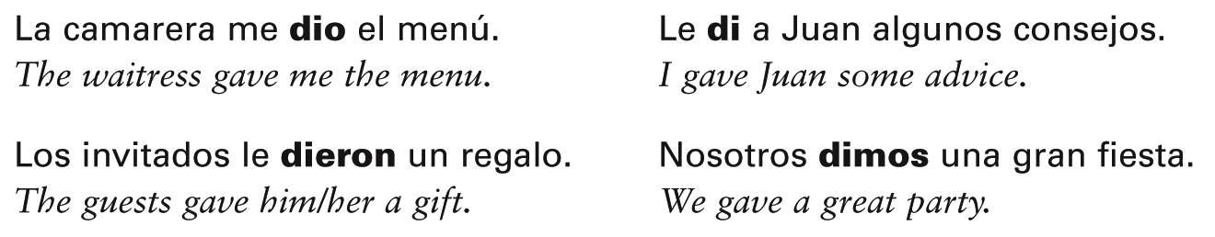
The endings for dar are the same as the regular preterite endings for -er and -ir verbs, except that there are no accent marks.

Slide 54
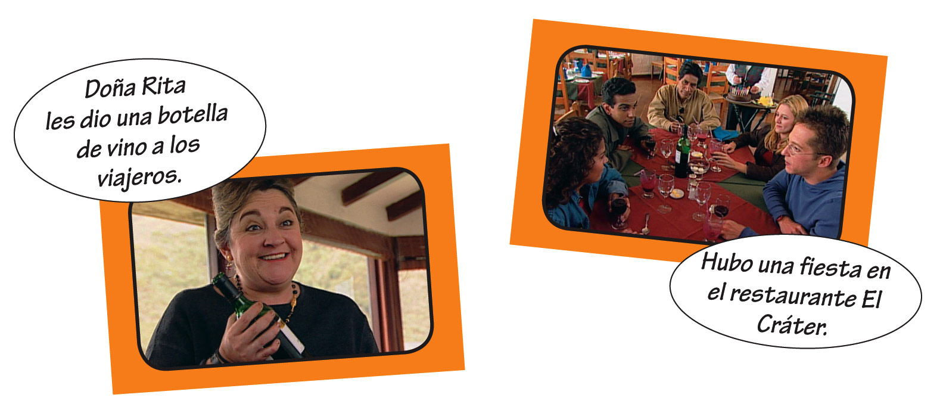
The preterite of hay (inf. haber) is hubo (there was; there were).

Slide 55
Escribe la forma correcta del pretérito de cada verbo que está entre paréntesis.
(querer) tú ________ (decir) usted ________ (hacer) nosotras ________ (traer) yo ________ (conducir) ellas ________ (estar) ella ________ | (tener) tú ________ (dar) ella y yo ________ (traducir) yo ________ (haber) ayer ________ (saber) usted ________ (poner) ellos ________
quisiste

Slide 56
Escribe la forma correcta del pretérito de cada verbo que está entre paréntesis.
(venir) yo ________ (poder) tú ________ (querer) ustedes ________ (estar) nosotros ________ (decir) tú ________ (saber) ellos ________ | (hacer) él ________ (poner) yo ________ (traer) nosotras ________ (tener) yo ________ (dar) tú ________ (poder) ustedes ________

Slide 57
Completar
Pagina 312: actividad 1

Slide 58
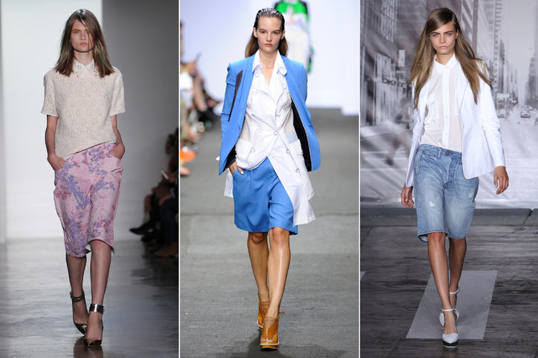
Time writing… 5 minutos!
Describe lo que llevan las modelos para esta temporada Primavera/ Verano 2014. Usa los verbos:
LLEVA
USA
TIENE PUESTO
Usa la mayor cantidad de detalles que puedas….

Slide 59
Práctica de Hablar…
Each one of you have a picture of a model. Explain in 5 minutes what does the model is wearing IN SPANISH without having your partner see the picture. Your partner needs to draw what you are describing. At the end, compare the pictures…
WHO UNDERSTOOD BETTER?

Slide 60
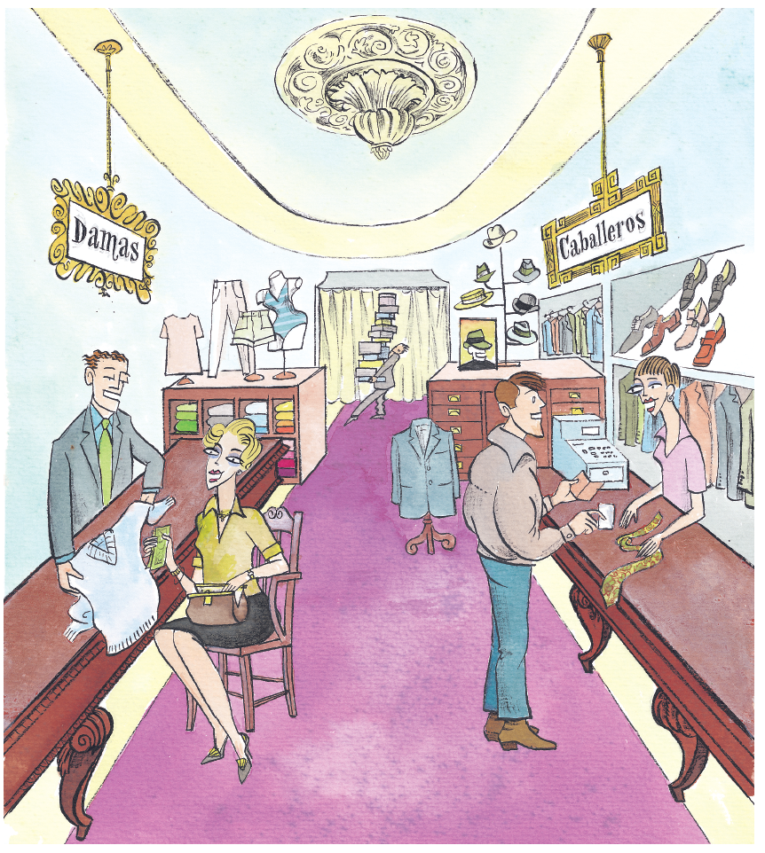

Slide 61
Calentamiento: Adjetivos Demonstrativos
Completa con el adjetivo demonstrativo correcto:
  This dress
  That blouse
  Those glasses (over there)
  These boots
  Those pants
  These shirts
  Those t-shirts
  This model

Slide 62
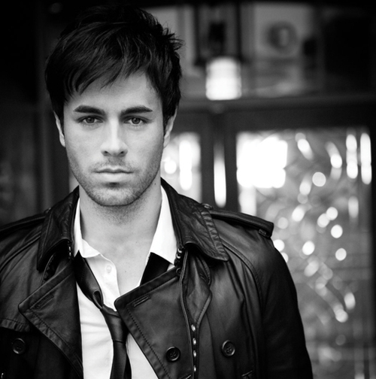
New Song
DIMELO!!!

Slide 63
Pelotazo…
Students stand in a circle. Start the game by saying an infinitive and tossing the ball to any student. The student must say the yo form of that verb and toss the ball at random to another student, who must say the tú form of the same verb, and so on until a verb is completely conjugated. If a student does not say a form correctly, he or she takes a seat and conjugates all forms of the same verb on a piece of paper. Once the student is done, he or she can come back to the circle and continue playing.
Once a verb is conjugated in every tense that we are studying (present or past) form, we will call out another infinitive for students to conjugate.

Slide 64
Verbos para jugar
COMPRAR
VENDER
ESCRIBIR
CERRAR
VOLVER
JUGAR
BUSCAR
LLEGAR
EMPEZAR
CREER
LEER
OÍR
COMER
SALIR
COMENZAR
ESTUDIAR
ASISTIR
EXPLICAR
HABLAR
DECIDIR
LLEVAR
MIRAR
NECESITAR
PRACTICAR

